Slide 1
COMPLETION UPDATE
03
VisionInspect AI
Milestone 3
Defect Classification & Manufacturing Analytics
Manufacturing Defect Detection & Quality Inspection System
MILESTONE STATUS
COMPLETED
All required Milestone 3 deliverables
Infosys Springboard Project • Weeks 5–6
VISIONINSPECT AI / INFOSYS SPRINGBOARD
01

Slide 2
MILESTONE 3 / WEEKS 5–6
Scope and implementation completed
Six deliverables moved the platform from defect intelligence to production-level quality insights.
01
Defect categorization workflows
02
Severity scoring & quality risk reports
MILESTONE 3 END STATE
From image findings to production insight
03
Quality assessment modules
04
Production quality reports
✓
Defect classification + analytics systems
✓
Quality control + reporting workflows
05
Defect analytics dashboards
06
Trend monitoring workflows
End-to-end inspection workflow
✓
COMPLETED SCOPE
Classification • Assessment • Reporting • Trends
VISIONINSPECT AI / INFOSYS SPRINGBOARD
02

Slide 3
STEP 01–02
Severity scoring and quality risk assessment
A weighted scoring framework converts classification results into consistent risk levels and recommended action.
DEFECT TYPE
→
SEVERITY SCORE
→
QUALITY DECISION
categorize
assess risk
act
SCORING PARAMETERS
30%
SIZE
25%
LOCATION
25%
DEFECT TYPE
20%
CONFIDENCE
physical scale
critical area
seriousness
model reliability
Severity Score = (Size × 30%) + (Location × 25%) + (Defect Type × 25%) + (Confidence × 20%)
LOW
MEDIUM
HIGH
CRITICAL
0–39
40–59
60–79
80–100
Illustrative framework example: Surface Crack → score 88 → Critical → Reject product and trigger the quality inspection workflow.
VISIONINSPECT AI / INFOSYS SPRINGBOARD
03

Slide 4
STEP 03–04
Quality control and production reporting
The completed modules connect defect intelligence with actionable quality-control decisions.
DELIVERED COMPONENTS
OUTPUT OF THE COMPLETED WORKFLOW
Quality decisions that can be reviewed
01
Classified finding
Defect type and category
02
Risk assessment
Severity score and quality risk
✓
Pass/fail decision generation
✓
Inspection reporting
03
Recommended action
Pass, rework, review or reject
✓
Quality recommendations
04
Production insight
Aggregated report for monitoring
✓
Production monitoring
Milestone output: a structured inspection record ready for QA review and production analytics.
VISIONINSPECT AI / INFOSYS SPRINGBOARD
04

Slide 5
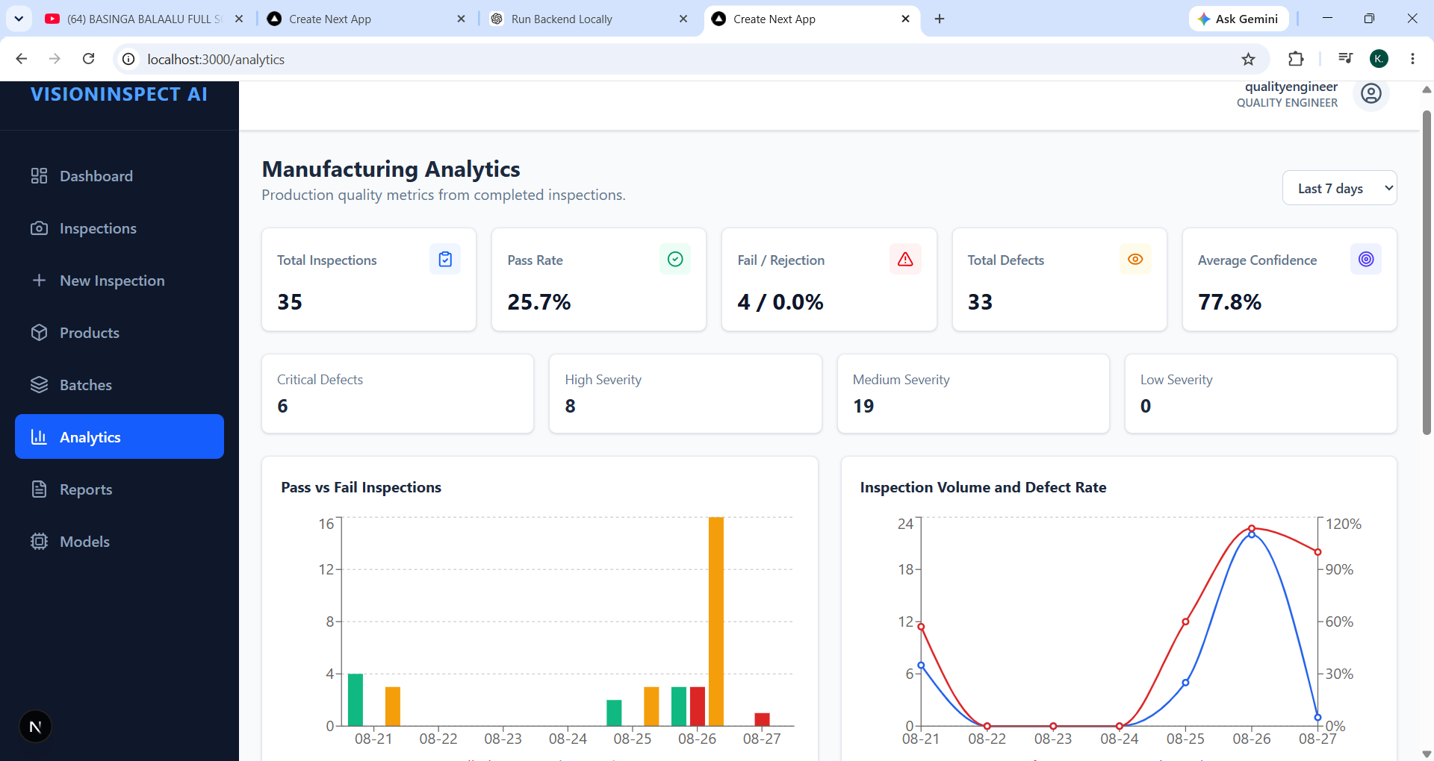
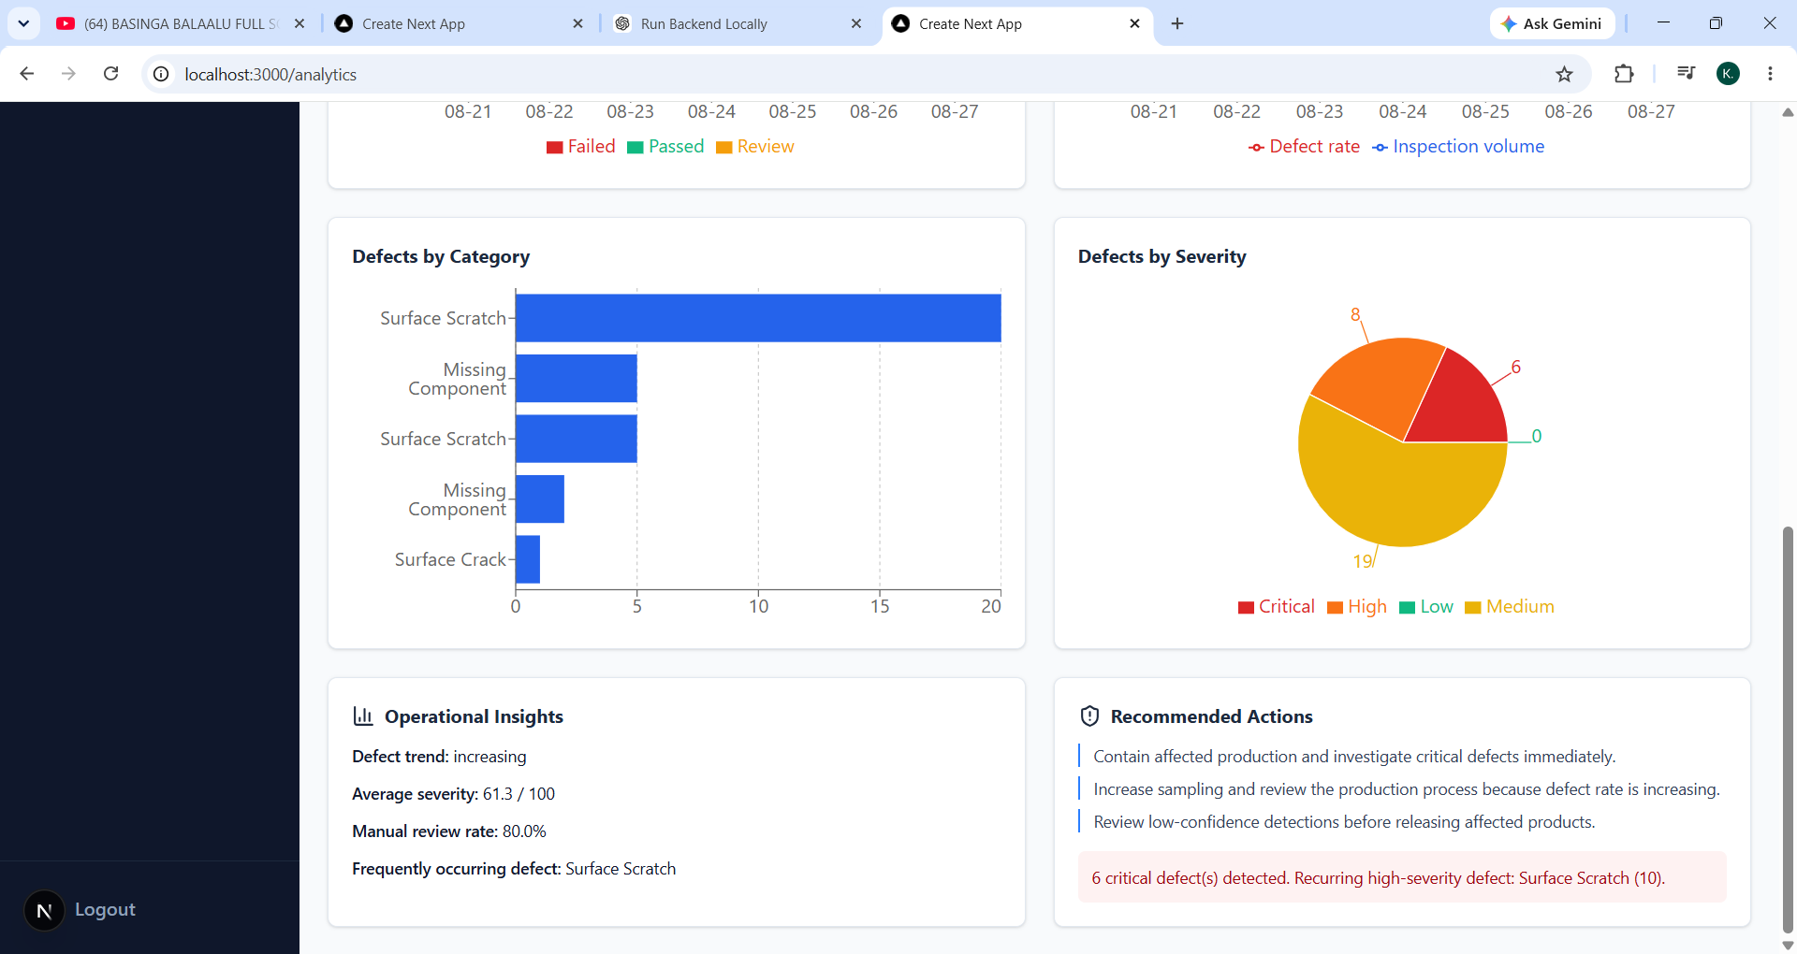
STEP 05–06
Manufacturing analytics dashboard
Insert screenshots of the completed analytics views below before presenting.
SCREENSHOT 01
Defect Analytics Dashboard
SCREENSHOT 02
Trend Monitoring / Production Report
INSERT DASHBOARD SCREENSHOT
INSERT DASHBOARD SCREENSHOT
Replace this placeholder with your evidence image
Replace this placeholder with your evidence image
Defect counts • categories • severity
Trend over time • pass/fail • inspection stats
DEFECT TREND ANALYSIS
PRODUCTION QUALITY REPORTS
INSPECTION STATISTICS & INSIGHTS
VISIONINSPECT AI / INFOSYS SPRINGBOARD
05

Slide 6
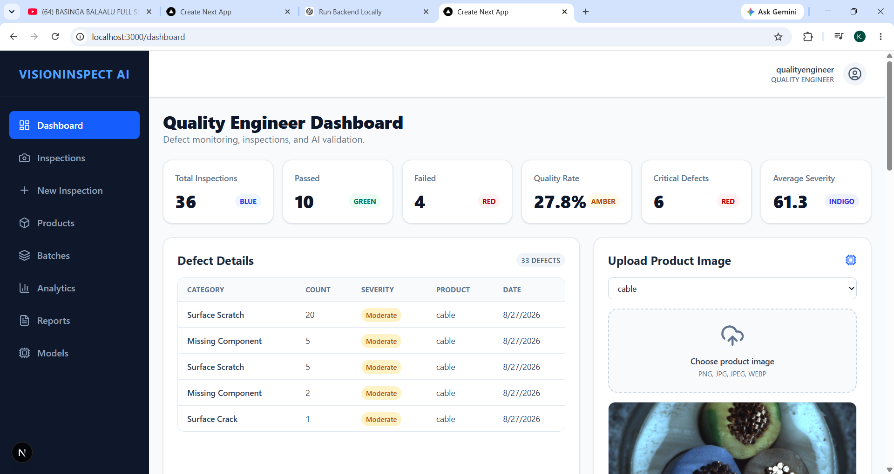
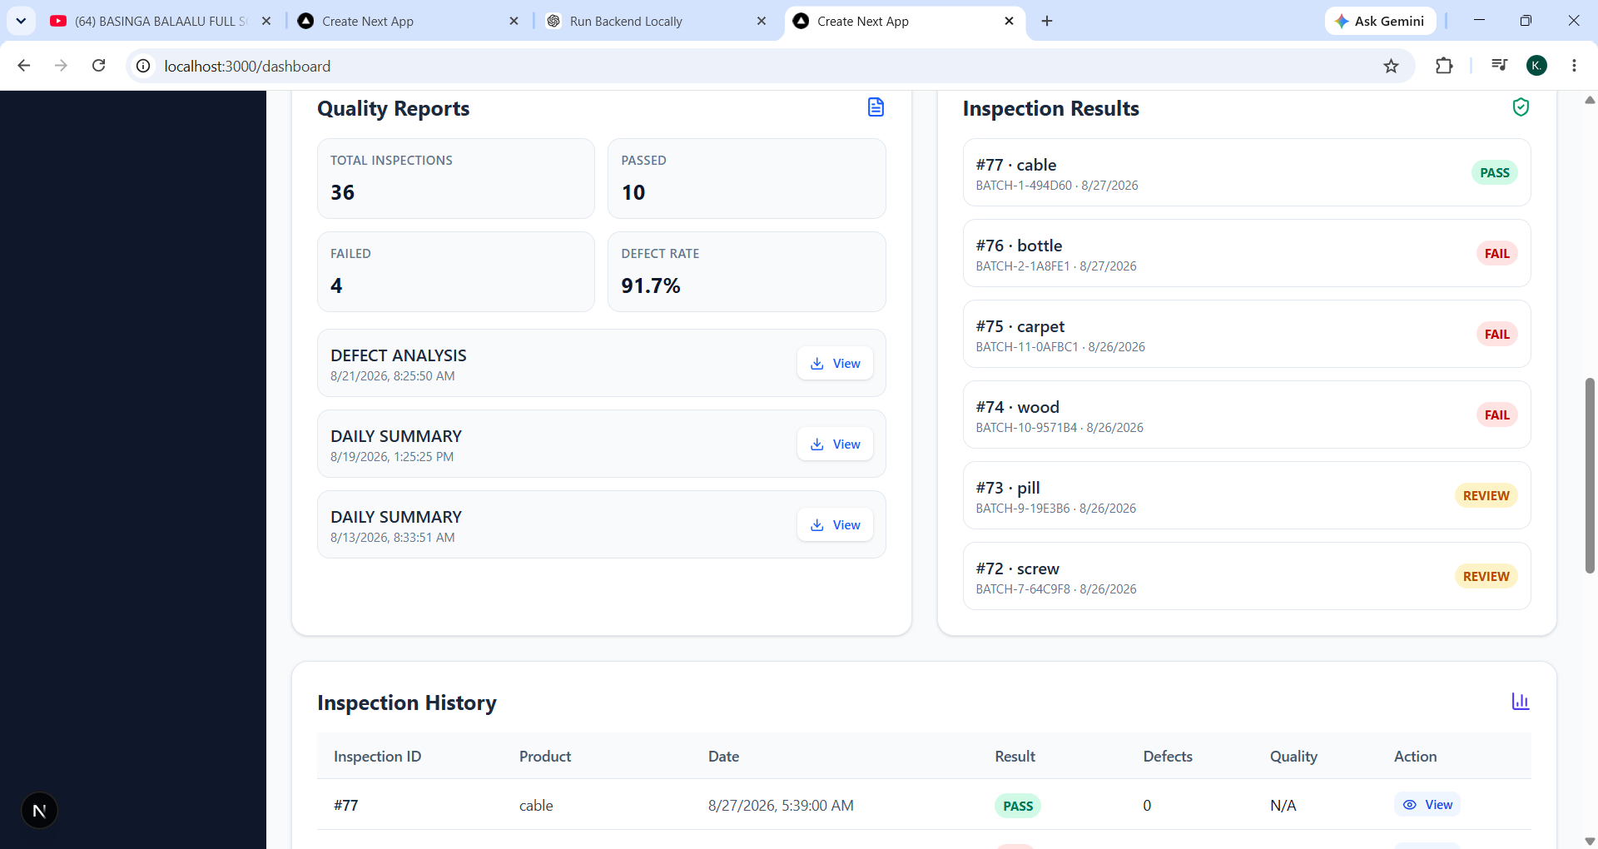
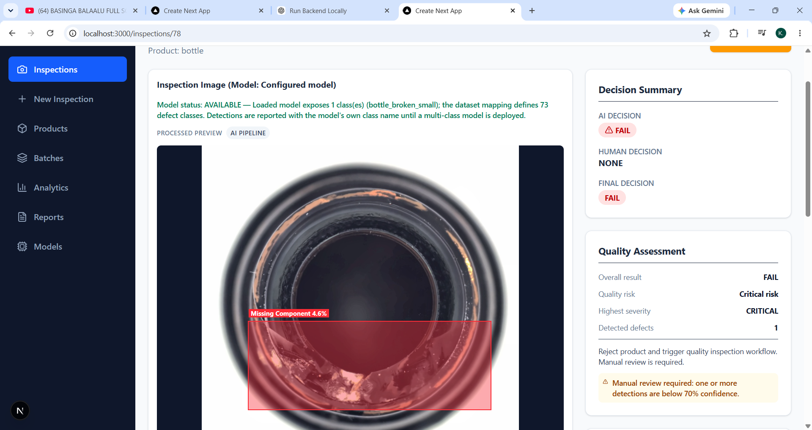
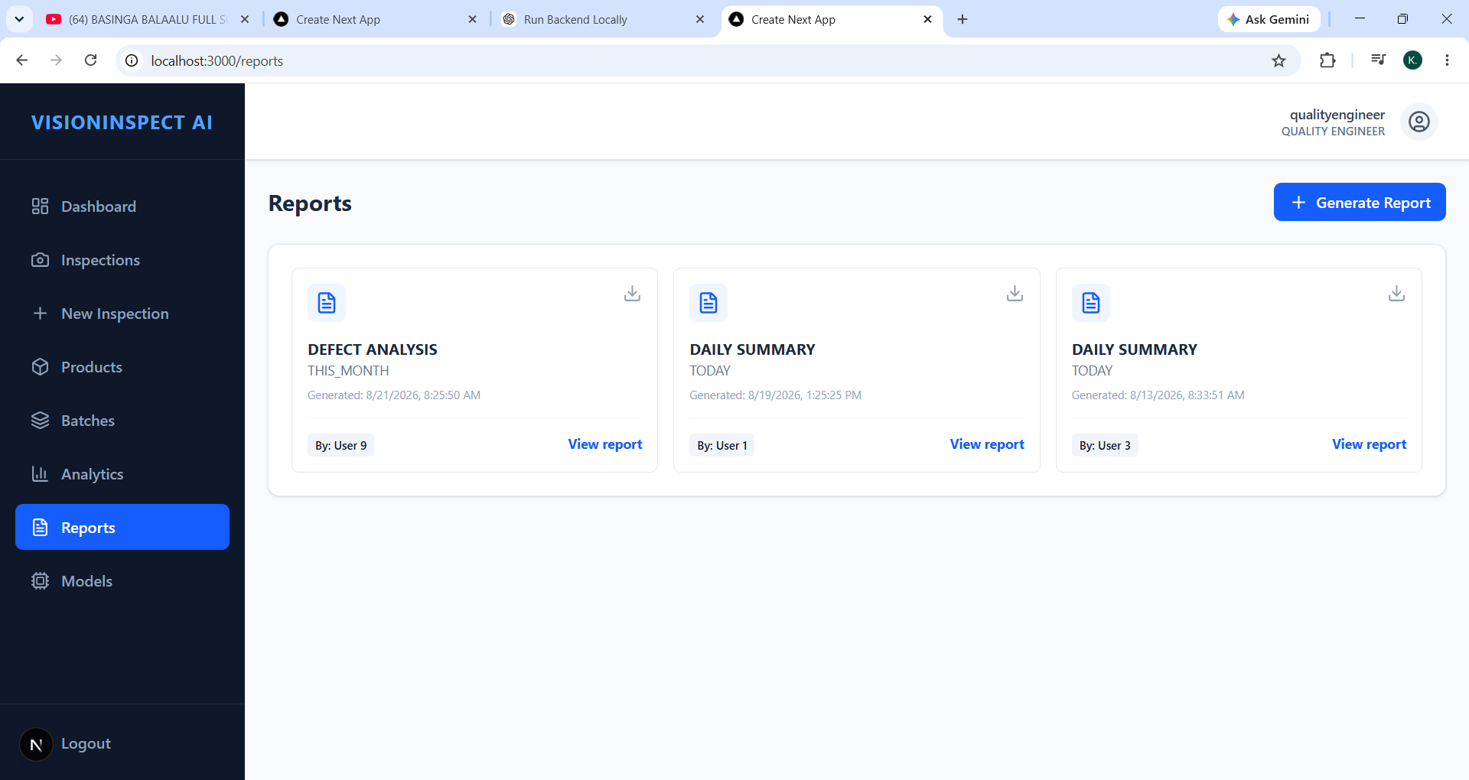

Slide 7
MILESTONE 3 / COMPLETE
Completion summary and next phase
The Milestone 3 criteria are addressed; the system is ready for testing, deployment and documentation.
EVALUATION CRITERIA
COMPLETION OUTCOME
✓
Classification + analytics dashboard implemented
A complete analytics layer for manufacturing inspection
✓
Quality assessment + severity reports functional
Production quality analytics generated
—
Defect intelligence → quality action
✓
—
Quality records → production insight
✓
Trend monitoring workflows integrated
—
Inspection workflow → end-to-end visibility
NEXT / MILESTONE 4 — TESTING, DEPLOYMENT & DOCUMENTATION • WEEKS 7–8
VISIONINSPECT AI / INFOSYS SPRINGBOARD
06

